Slide 1
North Seattle Human Services Summit
Tuesday, December 6, 2016 | City of Seattle
Mayor Murray | Councilmember Juarez

Slide 2
Data Limitations
Data Availability – Data sets are published at various times. For this presentation, the most recent data available was analyzed and presented. Only data sets published on a regular basis were used for analysis; sources include US Census and the American Community Survey, Washington State Behavioral Risk Factor Surveillance System, Healthy Youth Survey, and Washington State Office of Financial Management.
Sample Size – Small sample sizes impact data analysis, particularly when trying to disaggregate race/ethnicity. To address this fact, multiple years of data were combined.
Different Geographic Definitions – Geographic areas are defined differently depending on the data source. For example, King County Public Health refers to specific areas as Health Reporting Areas (HRA) while the US Census uses Census Tracts.
Self-Report Data – Data collected through surveys rely on self-reported data. Surveys include: the US Census, Washington State Behavioral Risk Factor Surveillance System, and Healthy Youth Survey.
Impact of University Students – Because the North Seattle Region includes the University of Washington, data related to this area is not always comparable to the rest of the region, specifically data related to financial and race/ethnicity.
1

Slide 3
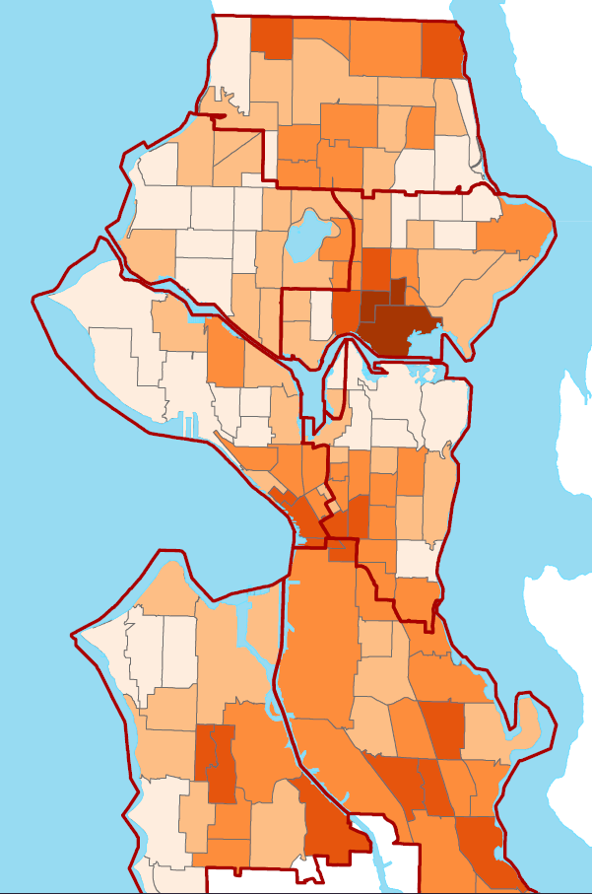
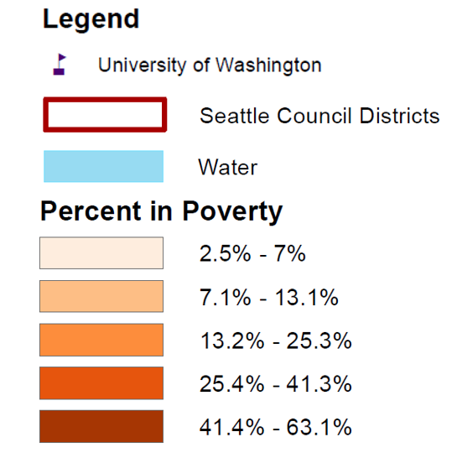
Neighborhoods in the northernmost part of Seattle—Bitter Lake, Cedar Park, and areas around Northgate and Lake City—experience high rates of poverty. However, consistently higher rates of poverty prevail in the southern part of Seattle.
Data Shown by: Census Tract
Data Source: US Census Bureau, 2010-2014 American Community Survey
Notes: Poverty defined as at or below 100% of the Federal Poverty Level
2

Slide 4
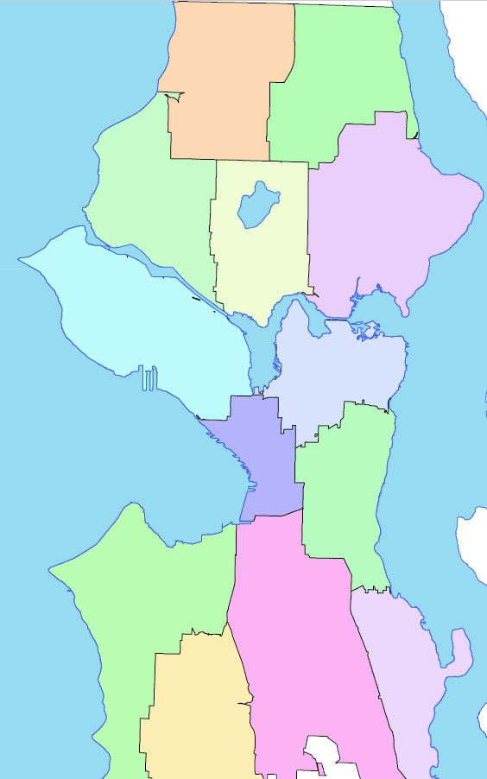
Seattle is organized into 13 Health Reporting Areas (HRA) created by Public Heath to help examine patterns across Seattle and King County:
Northwest
7%
North
7%
The North Seattle Region includes 5 HRA: Northwest, North, Ballard, Fremont/Greenlake, and Northeast.
Ballard
8%
Northeast
11%
41% of Seattle residents live in the North Seattle Region.
Fremont/Greenlake
8%
Health Reporting Area | # | %
Northeast | 69,162 | 11%
Ballard | 54,214 | 8%
Fremont/Greenlake | 53,847 | 8%
North | 45,979 | 7%
Northwest | 44,067 | 7%
QA/Magnolia | 61,591 | 10%
West | 54,422 | 8%
Capitol Hill/E.lake | 48,537 | 8%
Downtown | 48,395 | 8%
Central | 46,312 | 7%
Southeast | 43,050 | 7%
Beacon/Gtown/S.Park | 40,330 | 6%
Delridge | 31,095 | 5%
Total | 641,001 | 100%
QA/ Magnolia
10%
Capitol Hill/E.lake
8%
North Seattle Region
Downtown
8%
Central
7%
West
8%
Beacon/Gtown/
S.Park
6%
Southeast
7%
Delridge
5%
Data Shown by: Health Reporting Area (geographic definition used by Public Health)
Data Source: Revised 2001–2009; 2011 - 2015: Washington State Office of Financial Management, Forecasting Division, single year intercensal estimates 2001-2009; 2011 - 2015.
3

Slide 5
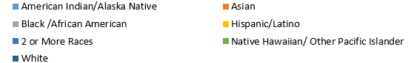
Communities of color make up 35% of the Seattle population.
Within this 35%, one-third live in the North Seattle Region. Asians, followed
by Hispanic/Latinos, make up the largest communities of color in this region.
Race/Ethnicity
Data Shown by: Health Reporting Area (geographic definition used by Public Health)
Data Sources: Revised 2001–2009; 2011 - 2015: Washington State Office of Financial Management, Forecasting Division, single year intercensal estimates 2001-2009; 2011 - 2015.
4

Slide 6
In Seattle, the Northeast HRA contains the largest population as well as the
largest population of residents between the ages of 15-24
(due to college-aged students attending the University of Washington).
Data Shown by: Health Reporting Area (geographic definition used by Public Health)
Data Sources: Revised 2001–2009; 2011 - 2015: Washington State Office of Financial Management, Forecasting Division, single year intercensal estimates 2001-2009; 2011 - 2015.
5

Slide 7
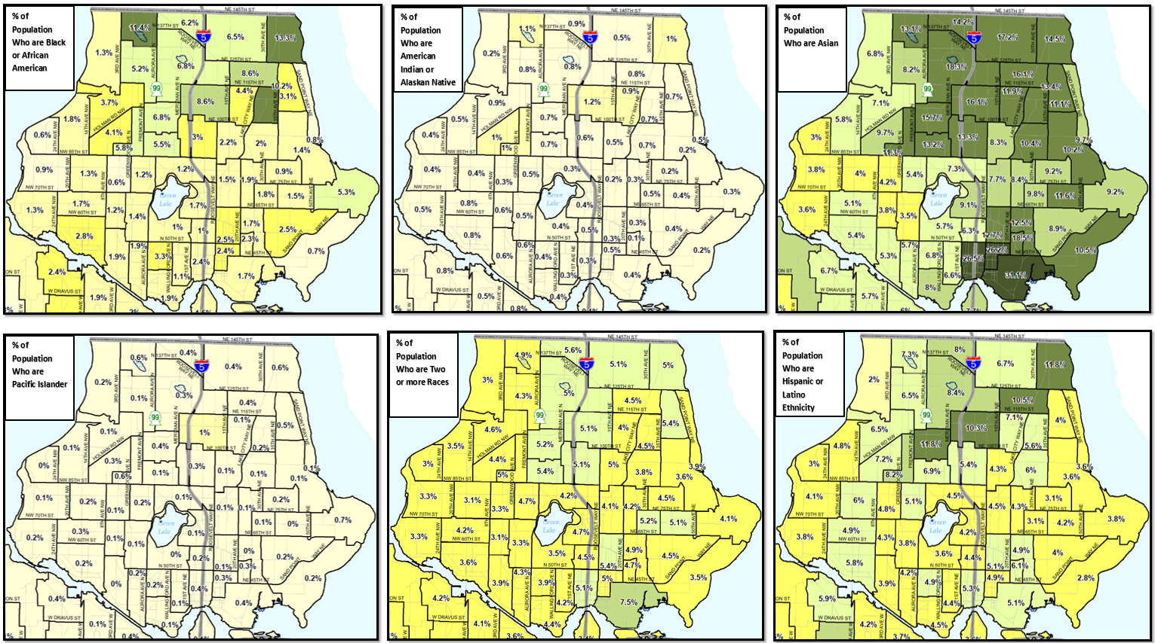
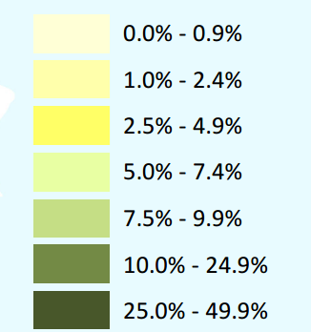
Neighborhoods in the northern most part of Seattle—Bitter Lake, Cedar Park,
and areas around Northgate and Lake City—have sizable Asian,
Black/African American, and Hispanic/Latino populations.
Percent of the Population
Data Shown By: Census Tract
Data Source: US Census Bureau, 2010
6

Slide 8
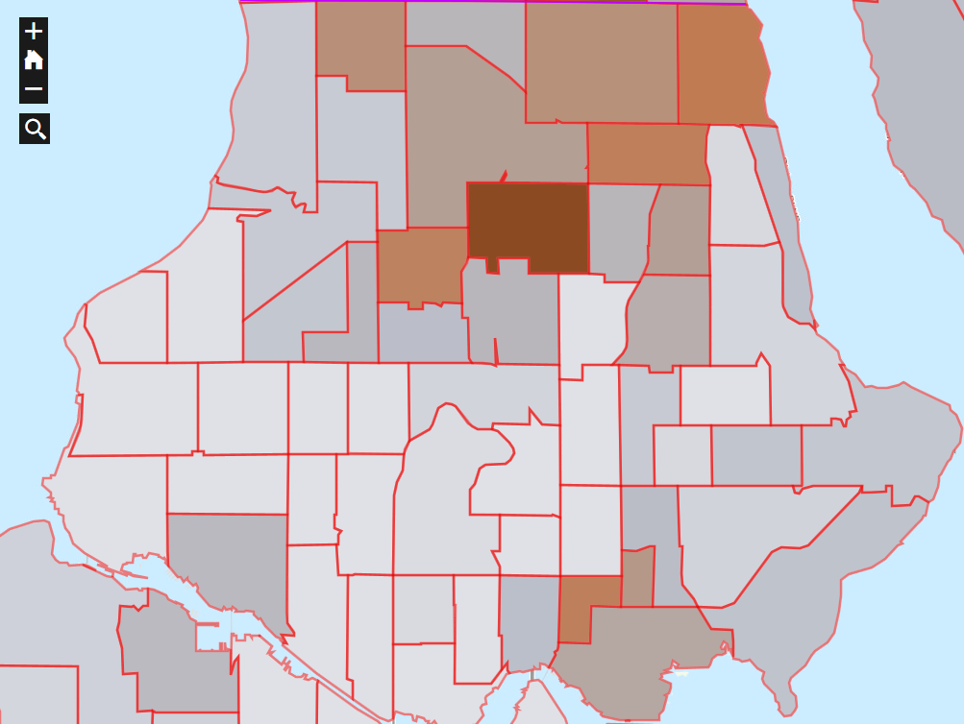
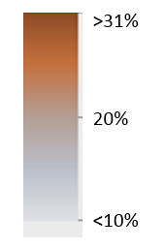

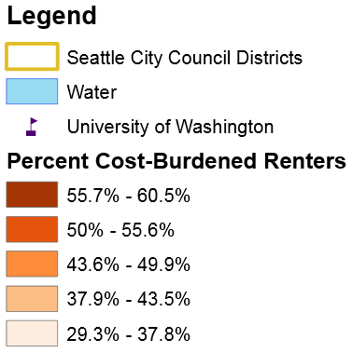
Neighborhoods in the northernmost part of Seattle—
Bitter Lake, Cedar Park, and areas around Northgate and Lake City—have high concentrations of foreign-born populations.
Percent of the Population
that is Foreign Born
>31%
20%
<10%
Data Shown By: Census Tract
Data Source: American Community Survey, 5-year Series 2009-2013
7

Slide 9
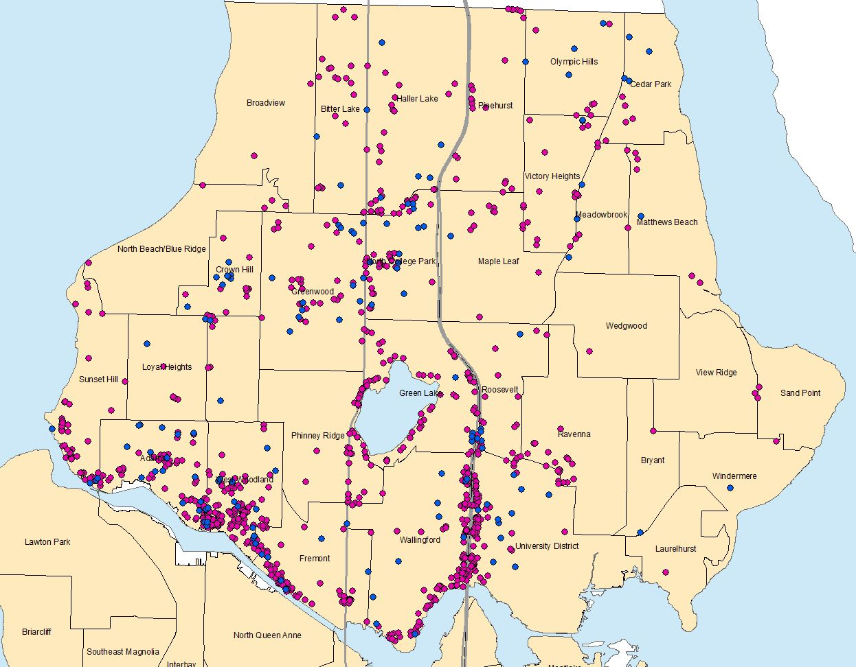
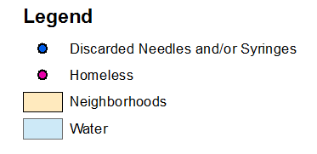
Between January 2015 and September 2016, the City of Seattle Customer Service Bureau received:
169 service requests regarding discarded needles in the
North Seattle Region.
1,633 service requests regarding homelessness in the
North Seattle Region.
Data Shown By: Seattle Neighborhoods
Data Source: City of Seattle Customer Service Bureau
8

Slide 10
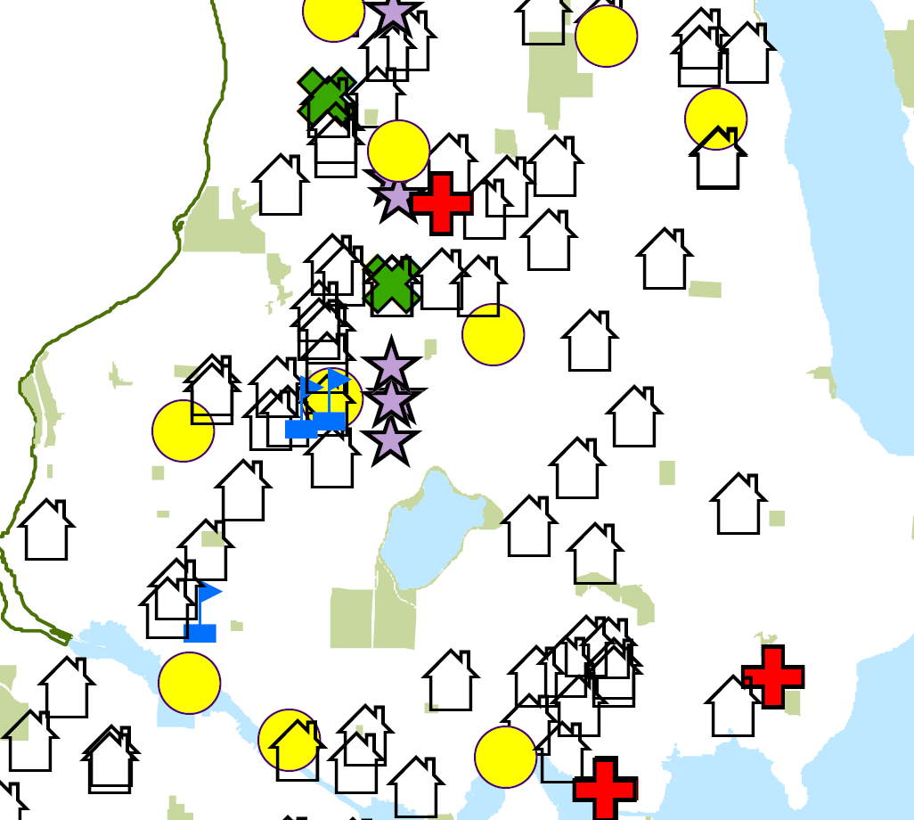
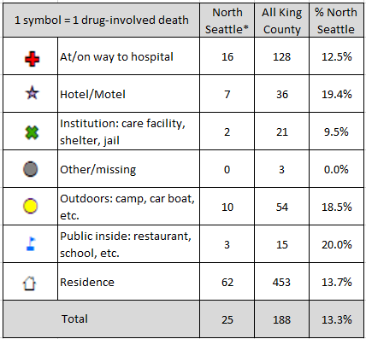
Between 2013 and 2015, the
North Seattle Region accounted for
nearly 13% of all deaths involving
major drugs (opiates, cocaine, or methamphetamines) in King County.
11
* Approximate count for North Seattle
1
4
9
Data Source: King County Medical Examiner Records; Analyzed by UW Alcohol & Drug Abuse Institute

Slide 11
Within the North Seattle Region, older adults living in the Northwest HRA are less likely to report being in excellent, very good, or good health. They are also less likely to receive the social/emotional support they need.
Compared to whites in the North Seattle Region, older adults of color report lower overall outcomes related to health and social/emotional support:
North Seattle Region by HRA | Older Adults (≥60) Reporting Excellent, Very Good, or Good Health | Older Adults (≥60) Receiving Social/Emotional Support they Need
Northwest | 75% | 73%
North | 80% | 82%
Ballard | 81% | 87%
Northeast | 88% | 83%
Fremont/ Greenlake | 91% | 84%
North Seattle Region by Race/Ethnicity | Older Adults (≥60) Reporting Excellent, Very Good, or Good Health | Older Adults (≥60) Receiving Social/Emotional Support they Need
White, non-Hispanic/ non-Latino | 85% | 84%
Non-whites* or Hispanic/Latino (Includes "other and "multiple races") | 75% | 72%
* All other race/ethnic groups other than white are grouped together because there are too few cases to adequately protect confidentiality and/or report reliable rates.
Data Shown by: Health Reporting Area (geographic definition used by Public Health)
Data Source: Health: Washington State Behavioral Risk Factor Surveillance System, 2005-2014
Social/Emotional Support: Washington State Behavioral Risk Factor Surveillance System, 2005-2012
Data Shown by: Health Reporting Area (geographic definition used by Public Health)
Data Source: Health: Washington State Behavioral Risk Factor Surveillance System, 2005-2014
Social/Emotional Support: Washington State Behavioral Risk Factor Surveillance System, 2005-2012
10

Slide 12
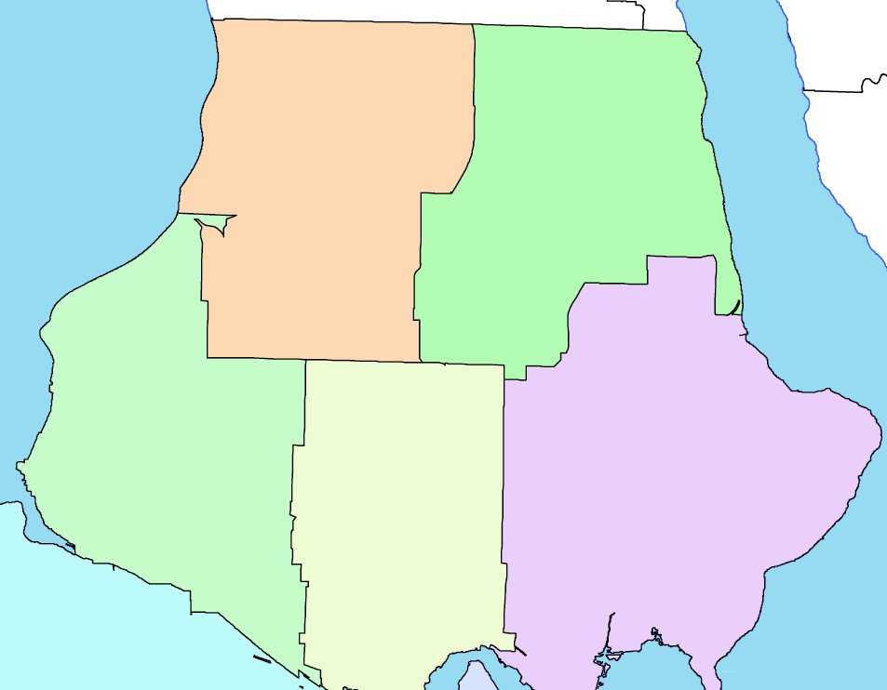
North Seattle Region: Percent of people with an unmet healthcare need due to cost
Within the North Seattle Region, people living in the Northwest HRA are more likely to go without healthcare
treatment due to costs.
Despite the Affordable Care Act:
Northwest
North
19%
7%§
1 out of 9 white, non-Hispanic/ non-Latino residents in the North Seattle Region have an unmet healthcare need due to cost
compared to
Ballard
1 out of 14§ non-whites* or Hispanic/Latinos (includes “other” and “multiple races”).
14%
Fremont/Greenlake
Northeast
6%§
4%§
§ Too few cases to meet precision standards, interpret with caution
* All other race/ethnic groups other than white are grouped together because there are too few cases to adequately protect confidentiality and/or report reliable rates.
Data Shown by: Health Reporting Area (geographic definition used by Public Health)
Data Source: Washington State Behavioral Risk Factor Surveillance System, 2014-2015
Note: Data was analyzed during the period when the health insurance marketplace was fully implemented through the ACA.
11

Slide 13
In the 2014-15 school year, North Seattle Region high school students—of all races—graduated at a higher rate than Seattle as a whole. However, racial disparities in North Seattle Region High Schools still exist: in general, white students graduated at higher rates than students of color.
All Seattle Public High Schools
High Schools in the North Region of Seattle: Ballard, Ingraham, Nathan Hale, & Roosevelt
Graduation Rate
≥83%*
White
1,175/1,376=85%
Graduation Rate <82%
Black/African American
416/633=66%
American Indian/ Alaska Native 17/32=53%
Hispanic/Latino
248/428=58%
Native Hawaiian/ Other Pacific Islander 18/23=78%
2 Or More Races
128/176=73%
Asian
571/685=83%
Graduation Rate ≥83%*
White
760/833=91%
Graduation Rate <82%
Black/African American
65/94=69%
American Indian/ Alaska Native 8/11=73%
Hispanic/Latino
95/127=75%
Native Hawaiian/ Other Pacific Islander 2/2=100%
2 Or More Races
57/68=84%
Asian
152/173=88%
* U.S. Average graduation rate for 2014-15 school year was 83%
Data Source: 2014-15 State of Washington, Office of Superintendent of Public Instruction
12

Slide 14
Taking into consideration the racial breakdown of 8th, 10th, and 12th graders, North Seattle Region middle and high school students of color are less likely than white students to have an adult to talk to about something important.
Data Source: Washington State Healthy Youth Survey, data available for even-numbered years: 2010, 2012, and 2014; 8th, 10th , and 12th graders surveyed with question about Having an Adult to Talk to About Something Important at 12 schools.
Note: Only percentages are available for this data.
13

Slide 15
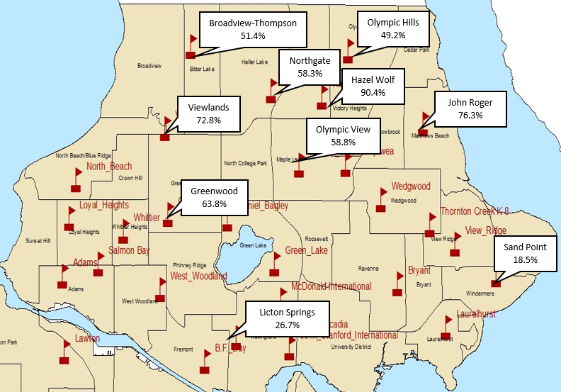
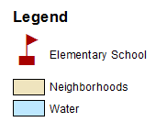
There are 28 elementary schools in the North Seattle Region. In the 2015-16 school year, 10 received state funding for full-day kindergarten:
North Seattle Region: Percent of children starting school in 2015
who were kindergarten-ready across all six categories of the
Washington Inventory of Developing Skills
Children entering kindergarten in these schools were assessed on readiness using the Washington Inventory of Developing Skills across 6 categories: social/emotional, physical, language, cognitive, literacy, and mathematics.
4 of the schools performed below the Seattle Public School average of 52.3%.
Seattle Public School Average: 52.3%
Data Shown By: Seattle Neighborhoods
Data Source: 2015-16 State of Washington, Office of Superintendent of Public Instruction
Note: Washington Inventory of Developing Skills is required only in state-funded full-day kindergartens. Absence of data for schools with enrolled kindergarten students may indicate that full-day kindergarten students in these schools are not state-funded.
14

Slide 16
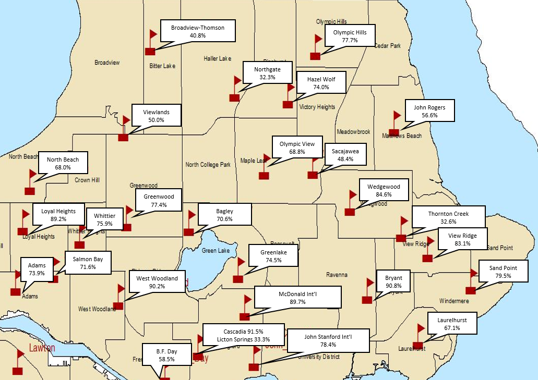
In general, children who do not read proficiently by the end of 3rd grade are 4 times more likely to
drop out of high school.
North Seattle Region: Percent of 3rd grade students in
2015-16 school year meeting grade-level reading standards
8 of the 28 elementary schools in the North Seattle Region performed below the Seattle Public School average of 65.7%.
Seattle Public School Average: 65.7%
Data Shown By: Seattle Neighborhoods
Data Source: 2015-16 State of Washington, Office of Superintendent of Public Instruction, The Annie E. Casey “Early Warning! Why Reading by the End of Third Grade Matters”
15

Slide 17
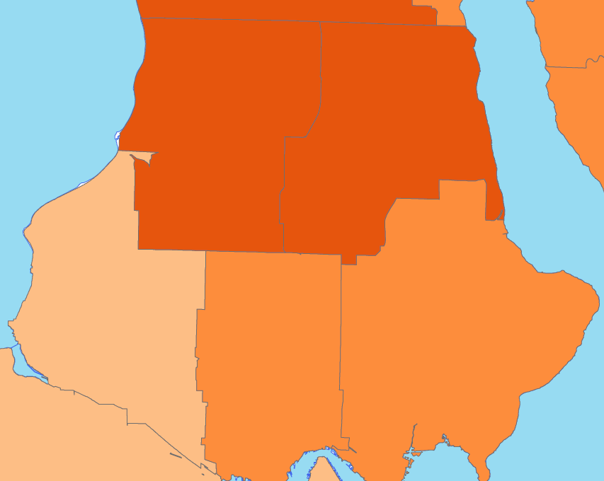
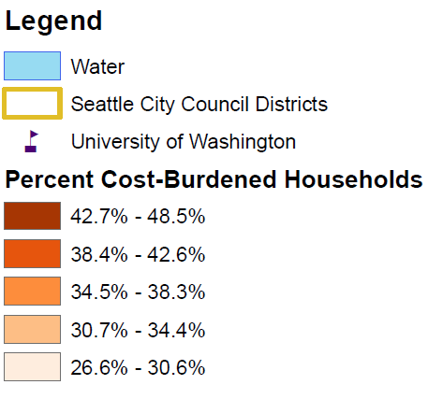

Overall, 37.8% of Seattle households—or 1 out of 3—spend 30% or more of their income on housing regardless of whether they rent or own a home.
North Seattle Region: Percent of cost-burdened households
(who spend 30% or more of income on housing) and
the percent of renters to homeowners by HRA
Likewise, 37.7% of households in the North Seattle Region are similarly cost-burdened.
Northwest
Renters: 50.2%
Homeowners:49.5%
North
Renters: 53.2%
Homeowners:46.8%
Ballard
Renters: 45.8%
Homeowners: 54.2%
Northeast
Renters: 43.8%
Homeowners: 56.2%
Fremont/
Greenlake
Renters: 56.4%
Homeowners:43.6%
Data Shown By: Health Reporting Area (geographic definition used by Public Health)
Data Sources: US Census Bureau, 2010-2014 American Community Survey.
16

Slide 18
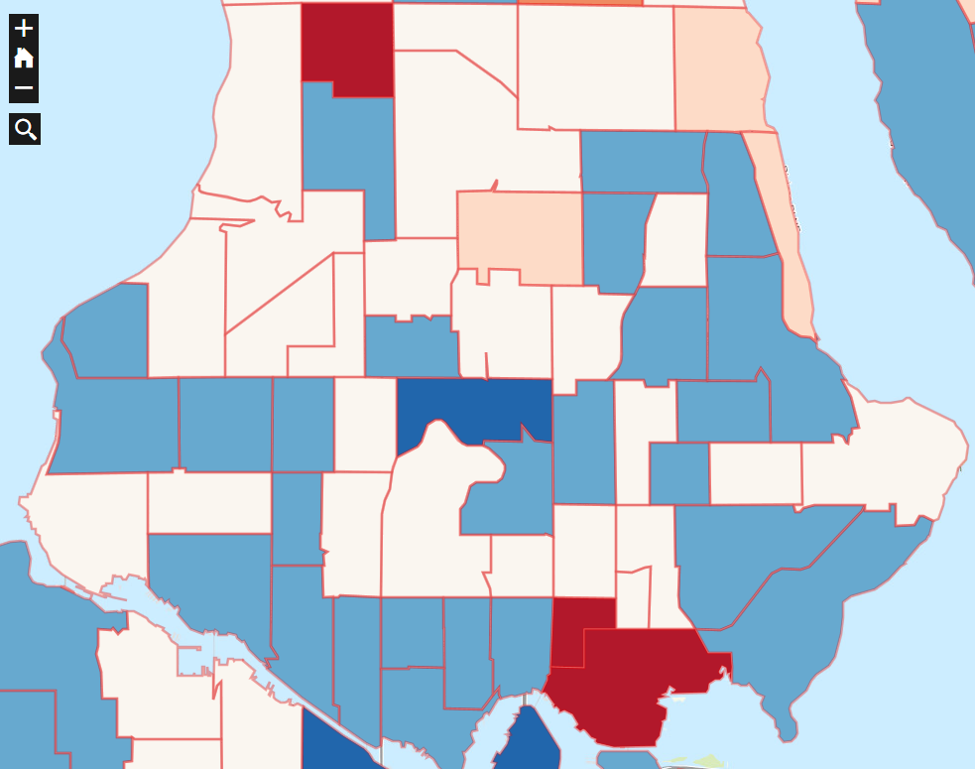
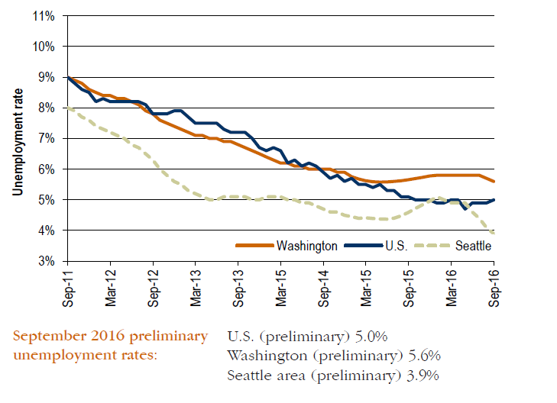

At the time of the 2010 U.S. Census,
Neighborhoods in the northernmost part of Seattle—
Bitter Lake, Cedar Park, and areas around Northgate and Lake City— had high rates of unemployment.
Current data for 2016, although not specific to the North Seattle Region, suggests unemployment is decreasing throughout
Seattle as a whole.
Legend
 |  | >16%
 |  | 12.8% - 16%
 |  | 9.5% - 12.8 %
 |  | 6.2 % 9.5 %
 |  | 2.9% -6.2%
 |  | <2.9%
Data Shown by: Census Tract
Data Source: US Census Bureau, 2010
17
Data Source: Washington State Employment Security Department

Slide 19
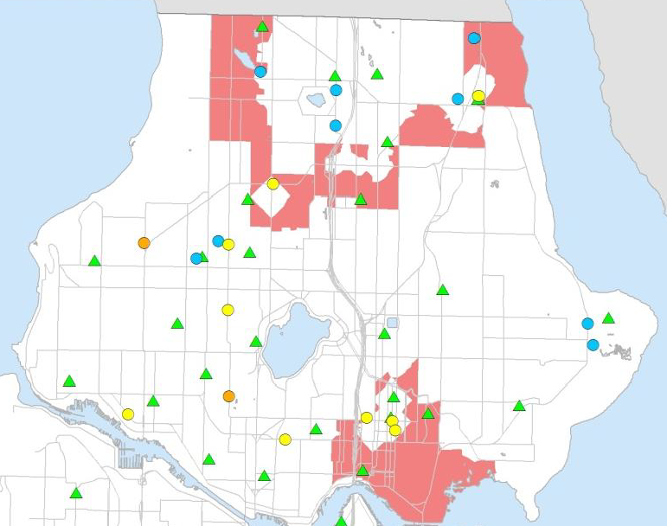
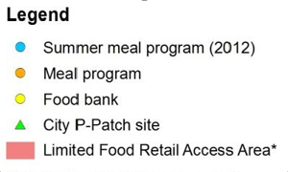
The North Seattle Region has several areas with limited food retail access. This is defined as an
area where:
Residents must travel more than ¼ mile to a food retailer (e.g. supermarkets, produce stands, and farmers markets)
The median household income is below 80% of the citywide median of $60,665
North Seattle Region: Limited Food Retail Access Areas
Additionally, some residents live near food retail areas but cannot afford to shop at them. This cost barrier leads them to seek more affordable food options farther away from home.
18
Data Source: US Census Bureau, 2006-2010 American Community Survey, Washington State Department of Social and Health Services, Public Health- Seattle & King County, King County GIS Center, and City of Seattle

Slide 20
On average 10% of adults living in the North Seattle Region experience food insecurity.
North Seattle Region: Percent of people experiencing food hardship
16% non-whites* or Hispanic/Latinos (includes “other” and “multiple races”)
Northwest
North
16%
7%
compared to
8% of white, non-Hispanic/non-Latino residents in the North Seattle Region
indicated "sometimes" or "often" in the past 12 months their food did not last and they didn't have money to buy more.
Ballard
8%§
Fremont/Greenlake
Northeast
5%§
16%
§ Too few cases to meet precision standards, interpret with caution
* All other race/ethnic groups other than white are grouped together because there are too few cases to adequately protect confidentiality and/or report reliable rates.
Data Shown by: Health Reporting Area (geographic definition used by Public Health)
Data Source: Washington State Behavioral Risk Factor Surveillance System, 2007 and 2011-2013
Note: Data was analyzed during the period when the health insurance marketplace was fully implemented through the ACA.
19

Slide 21
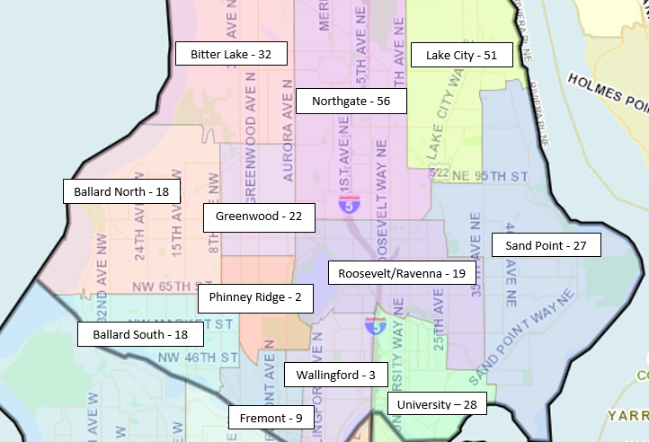
Between January 2015 and September 2016, the Seattle Police Department filed 1,027 reports of
domestic violence involving aggravated assault.
6% of Seattle 8th, 10th , and 12th graders report being physically hurt on purpose by a
dating partner in the past 12 months.
In the North Seattle Region this number was 5%.
285 of those reports—or 28%—
were filed in the North Seattle Region.
Data Shown By: Micro-Community Policing Plans
Data Source: Seattle Police Department Crime Dashboard, http://www.seattle.gov/seattle-police-department/crime-data/
crime-dashboard
20
Data Sources: Washington State Healthy Youth Survey, data available for even-numbered years: 2010, 2012,
and 2014; 8th, 10th , and 12th graders surveyed at 12 schools.

Slide 22
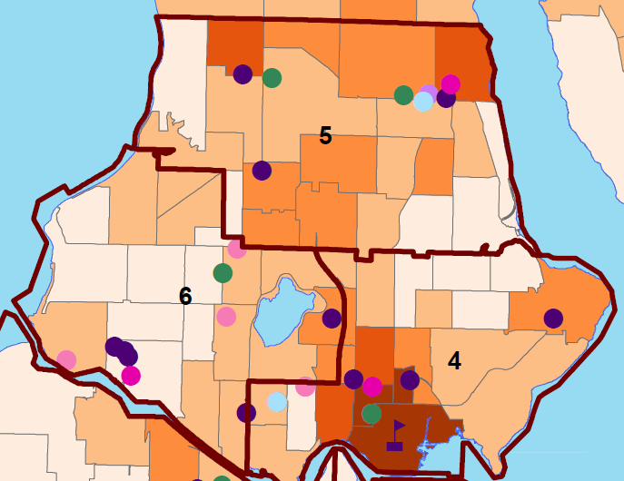
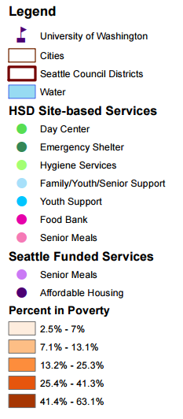
City of Seattle
Funded Services
Meals
Data Shown By: Census Tract
Data Sources: US Census Bureau, 2010-2014 American Community Survey
21

Slide 23
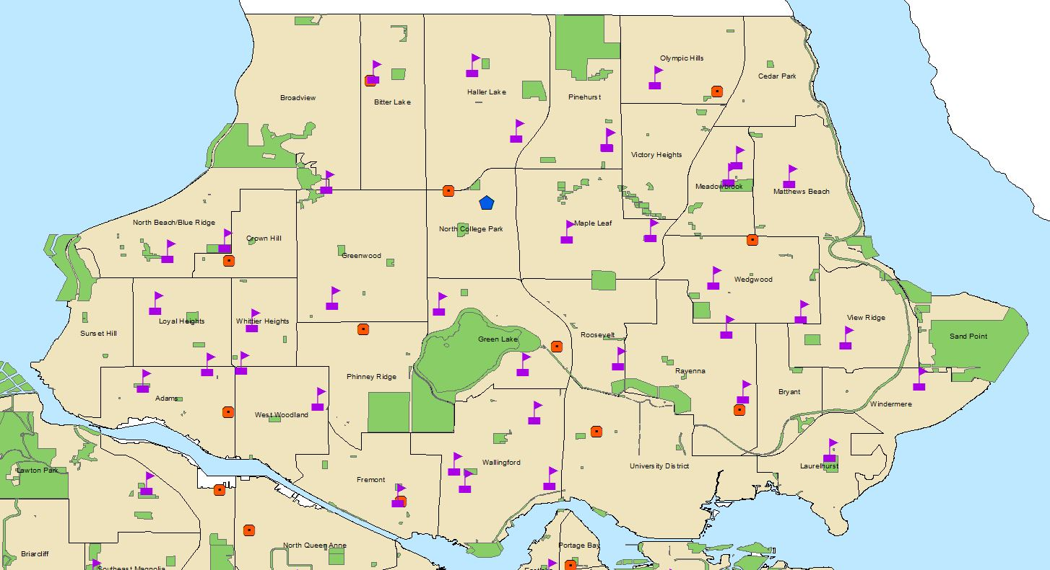
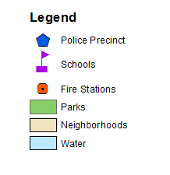
Community Assets
22
Data Shown By: Seattle Neighborhoods

Slide 24
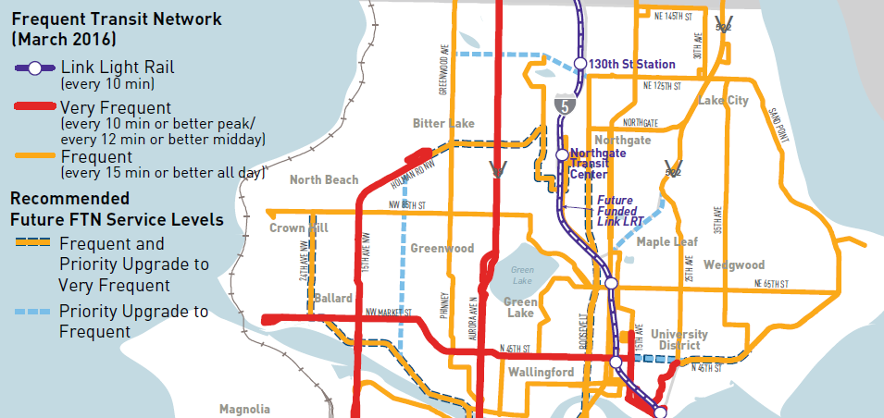
Public Transportation Network
Includes currently funded future transit
23
Data Source: City of Seattle, King County

